Slide 1
Psychological Aspects of Pandemics
André Calero Valdez

Slide 2
Agent-based Modelling using Agents.jl
Why Julia?
Easy to program (similar to Python, works in Jupyter NBs)
Easy Matrix operations (like Matlab)
Fast at runtime (like C)
Why Agents.jl?
Easy to generate models?
Easy to extend to large simulation
Do not have to learn NetLogo?
Why not Agents.jl?
NetLogo provides faster feedback to explore basic ideas
Performance is seldom a problem

Slide 3
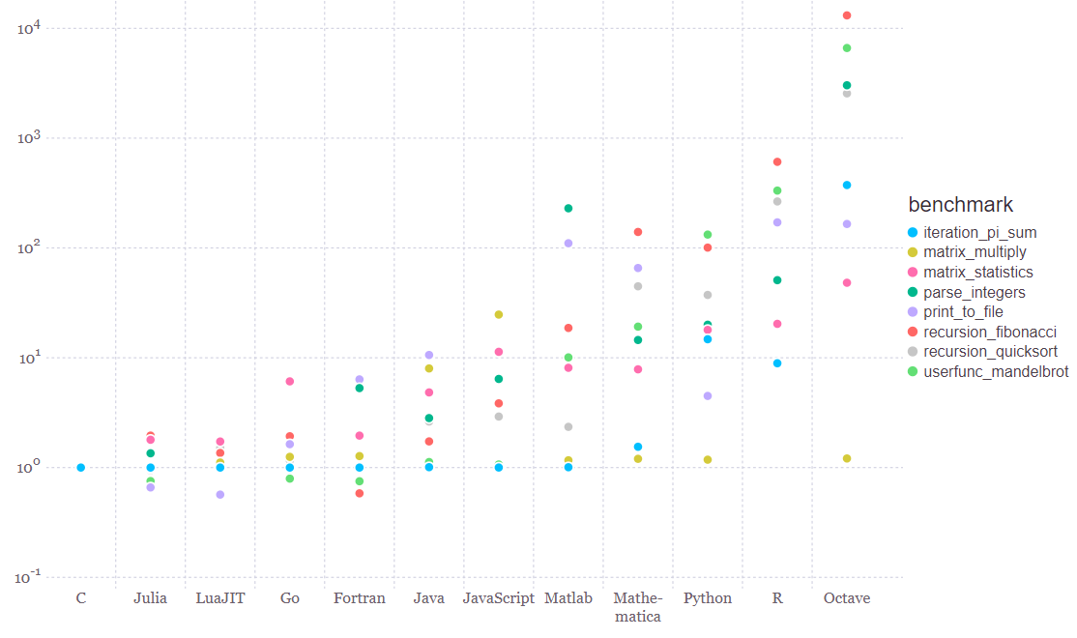
Reference benchmarks from Julia website
Execution time relative to C for different reference computational tasks

Slide 4
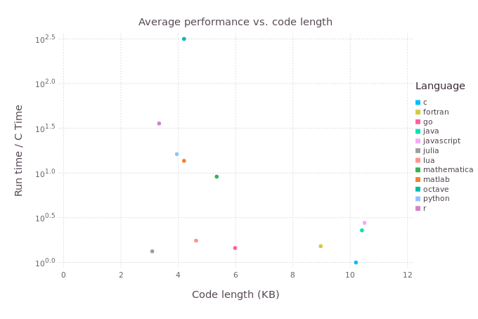
Language Code Complexity vs Execution Speed
Octave
R
Python
Matlab
Lua
JavaScript
Java
Julia
Go
C
Fortran
Source: http://www.oceanographerschoice.com/2016/03/the-julia-language-is-the-way-of-the-future/

Slide 5
Central ideas in Julia
Metaprogramming made easy (@time)
No two-language problem (R + CPP & RCPP)
Libraries are written in Julia, not hotcode/gluecode
Free to use
Integration with other languages
Fortran (native call)
C/C++ (native call)
Python (native call)
Gnu R (transparently load R session inside Julia)
Java (transparently load JVM inside Julia)

Slide 6
Central Ideas in Julia
Performance
Dynamically compiled to optimized native machine code
Scalability
SIMD, Threading, Distributed computing
Modern design of the language
multiple dispatch, metaprogramming, type system
MIT License
corporate-use friendly (also package ecosystem)

Slide 7
Central ideas in Julia
Julia is not object-oriented!
Julia uses mulitple dispatch
“methods“ are not part of class hierarchy
Data type hierarchy instead of classes
Methods are part of the module scope, but resolve polymorphism using signature
Composability for free!
See https://www.youtube.com/watch?v=kc9HwsxE1OY

Slide 8
Simple example – threading
Single threaded
Multithreading
function ssum(x)
r, c = size(x)
y = zeros(c)
for i in 1:c
for j in 1:r
y[i] += x[j, i]
end
end
y
end
function tsum(x)
r, c = size(x)
y = zeros(c)
Threads.@threads for i in 1:c
for j in 1:r
y[i] += x[j, i]
end
end
y
end

Slide 9
Typical pattern for distributed simulation
using Distributed
addprocs(4);
@everywhere include("sim_file.jl")
function init()
Random.seed!(myid())
end
@sync for wid in workers()
@async fetch(@spawnat wid init())
end

Slide 10
Writing distributed loops
data = @distributed (vcat) for i = 1:10000
some_param_A = rand()
some_param_B = rand()
res_1, res_2, res_3 = run_sim();
(sim_stats(res_1,res_2,res_3)...,
some_param_A,
some_param_B,
myid())
end

Slide 11
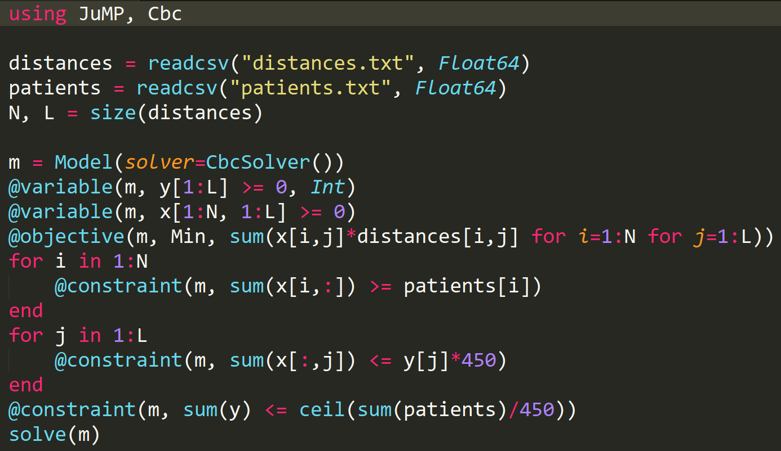
Use-Case Constraint Solving
Use Case 2 Julia @ Ministry of Health, Poland Optimal allocation of accelerators in radiotherapy

Slide 12
Agents.jl
YouTube Tutorial Videos (me): https://t1p.de/agentsjl
Website: https://juliadynamics.github.io/Agents.jl/stable/
Good Youtube Tutorial (George Datseris): https://www.youtube.com/watch?v=DJSHXXjkwLY

Slide 13
Related Packages
DataFrames.jl – for data analysis in Julia
Graphs.jl – for complex networks and weighted graphs (incl. Network generators)
Optimization.jl – (e.g. minimzing Cost function)
Distributions.jl - generating random numbers
Measurements.jl – uncertainty in measurements

